Slide 1
SMART TIC TAC
﷽
حَسْبُنَا اللَّهُ وَنِعْمَ الْوَكِيلُ

Slide 2
ABOUT US
1.SAYEED SADMAN SAAD-------ID:C231112
2.TAREK AZIZ WALID------------ID:C231111
3.MD. MOHSEN-------------------------ID:C231101
4.SAZZAD HOSSEN CHOWDHURY--ID:C231113

Slide 3
What is TIC TAC game?
Tic-tac is a game in which two players take turns in drawing either an ‘O' or an `X' in one square of a grid consisting of nine squares. The winner is the first player to get three of the same symbols in a row,Column and diagonal.Which is known as tic tac toe.

Slide 4
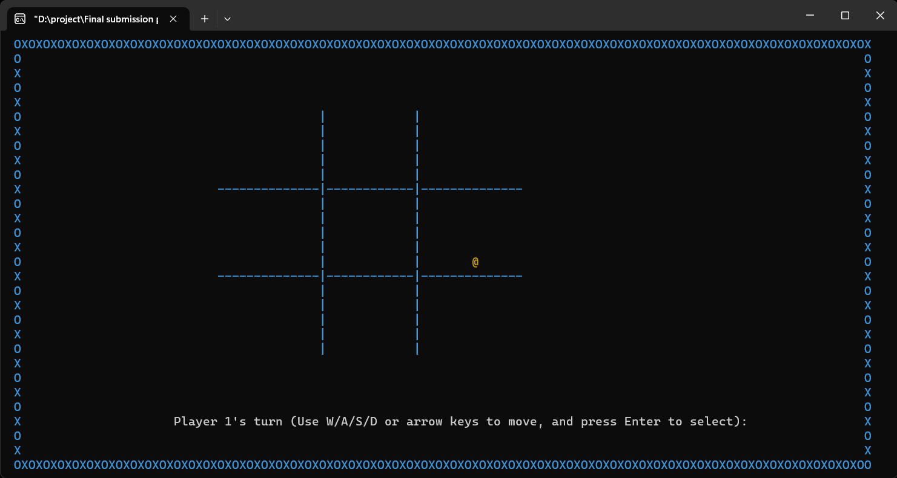
1.This game is recreated by us with adding some color effects.
2.In this game we added some sound feature and they are game starting sound and game winning sound.
3.For selecting your choice you have to move your cursor point with W/A/S/D and arrow key.

Slide 5
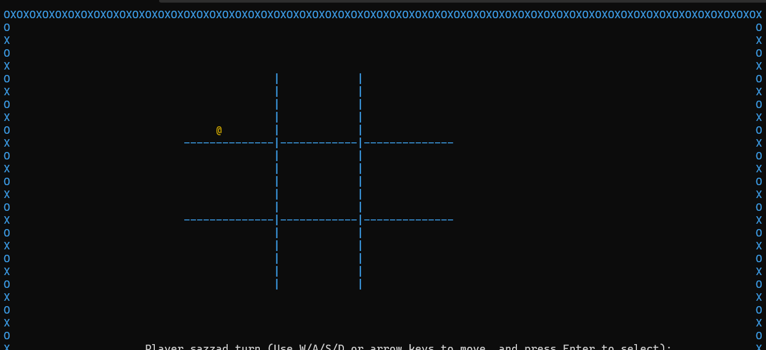
4.Here is a suitable option for you (@) that indicates the point where you are in current position.

Slide 6
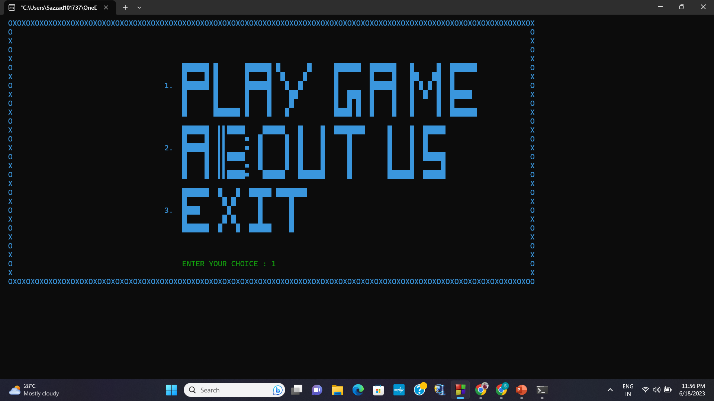
Features
There are three option in the interface:
1.Play game
2.About us
3.Exit

Slide 7
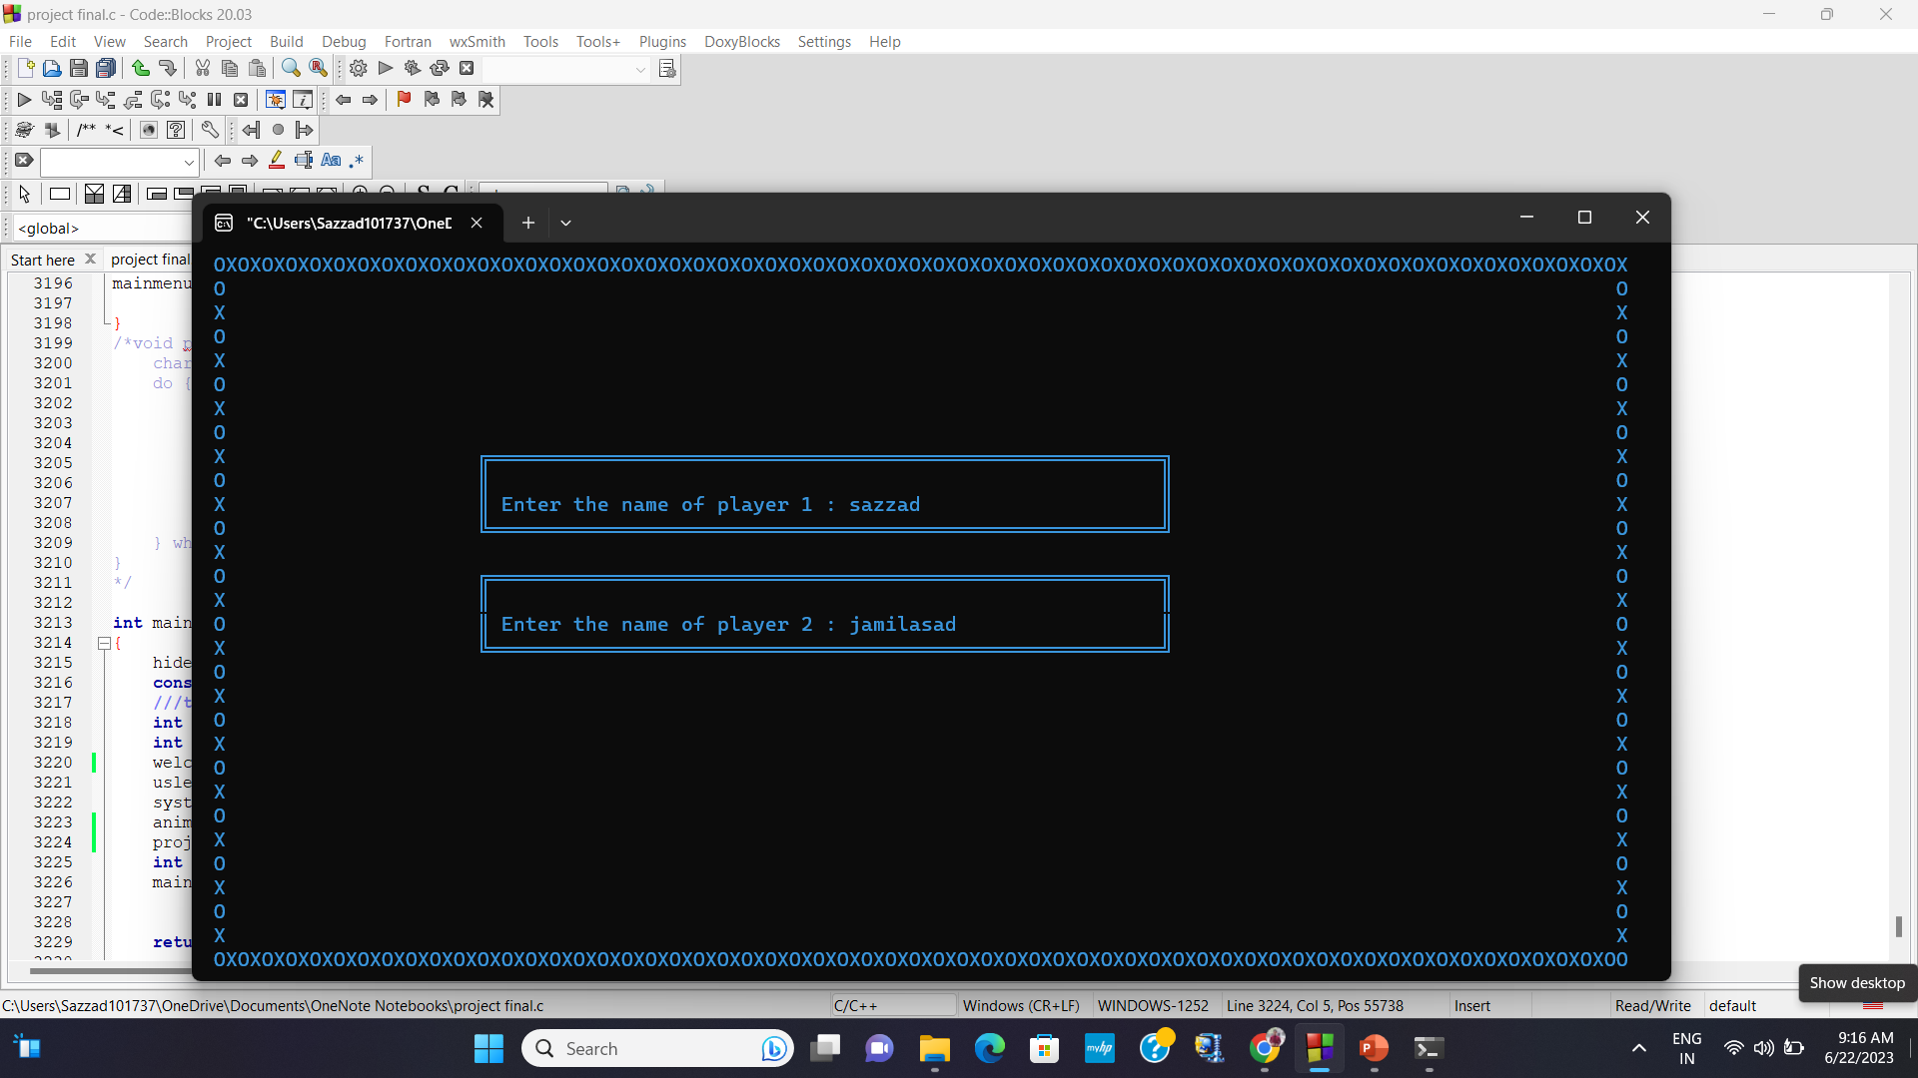
If a player choose option 1.
#Player 1 will enter his/her name in 1st box.
then
#Player 2 will enter his/her name in 2nd box.
#Then he/she will press enter key to continue…..

Slide 8
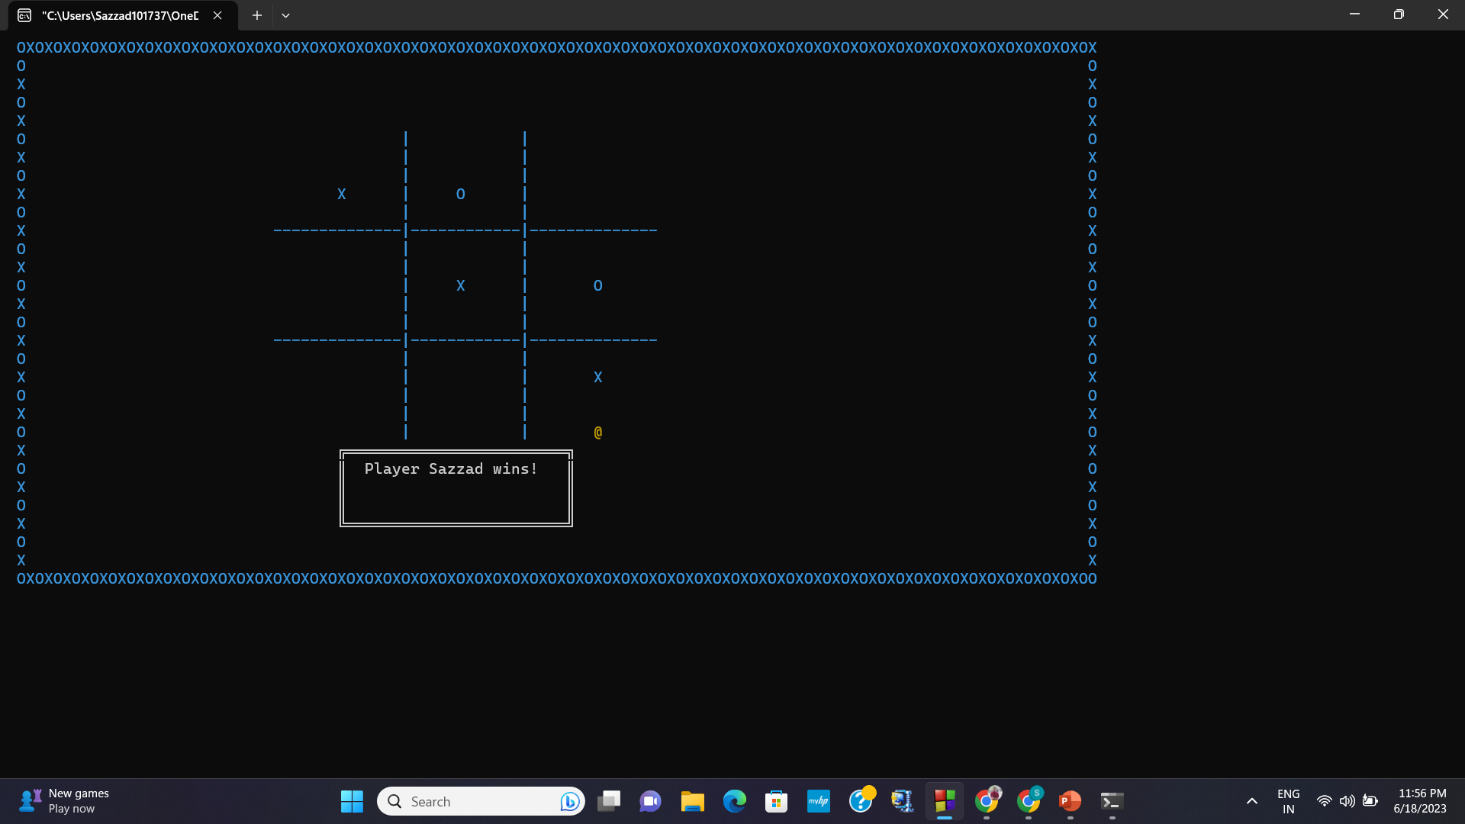
How to play…
W—UP( )
A---LEFT( )
S---DOWN( )
D---RIGHT( )
Press Enter to select….

Slide 9
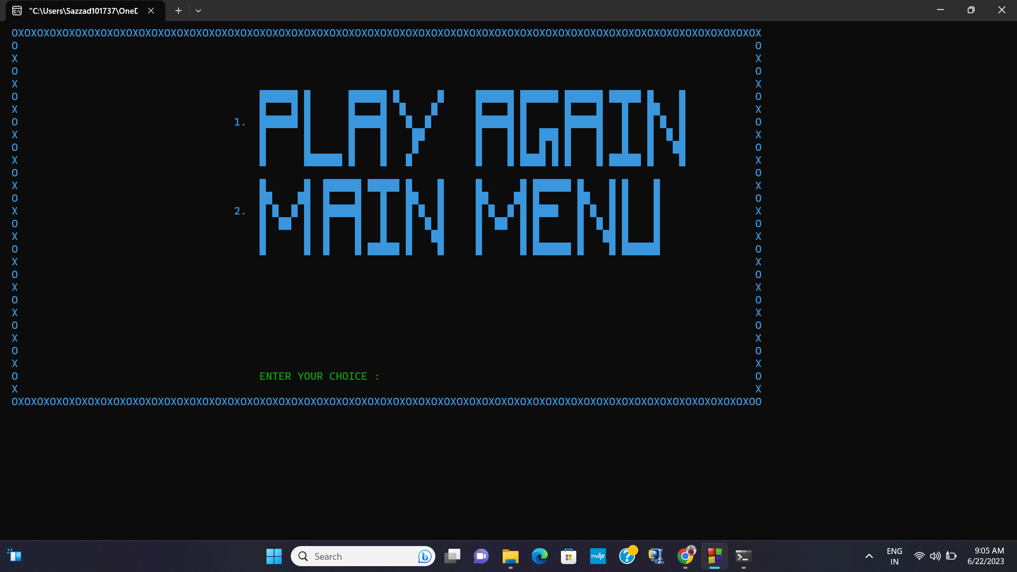
After playing:
Press enter to continue to next page
There will be 2 options
1.Play again:
If player choose option 1 he/she can play again this game
2.Exit:
If player choose option 2 this game will return to main menu.

Slide 10
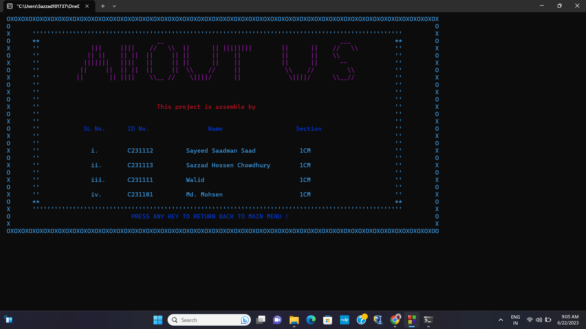
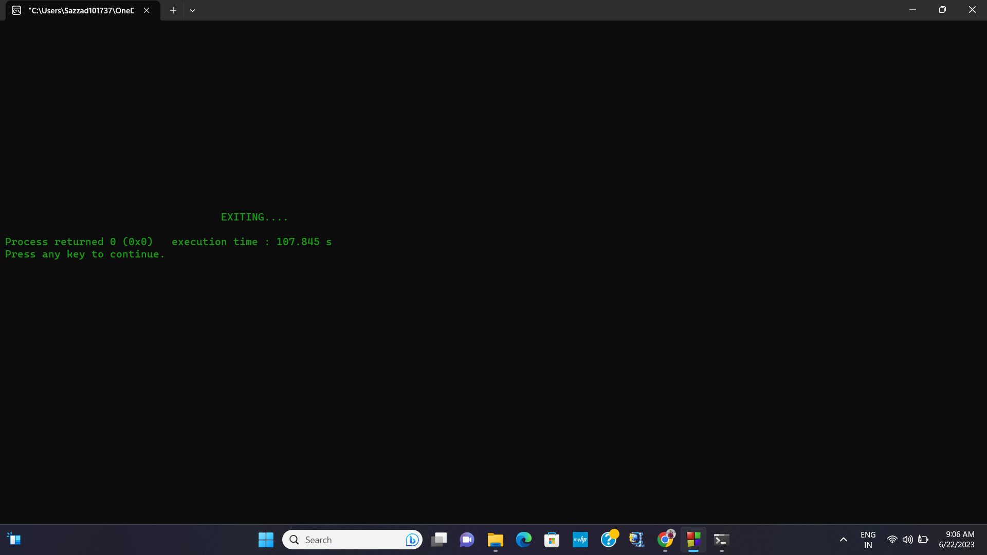
#If player select option 2 then he/she will see the information of the video game developer.
#If player select option 3 the game will end….

Slide 11
THANK YOU
"Allah is Sufficient for us, and He is the Best Guardian; The Excellent Protector and The Excellent Helper." (3:173 & 8:40)

